Slide 1

ECE 448: Spring 2018
Lab 3 – Part 2
Design of Controllers
Using ASM Charts

Slide 2
Agenda for Today
Part 1: Post-synthesis and Timing Simulation
using Vivado Simulator
Part 2: Discussion of Solutions to Class Exercise 1
Part 3: Introduction to Class Exercise 2
Notes:
2

Slide 3
Part 1
Hands-on Session on
Post-synthesis and Timing Simulation
Using Vivado Simulator
Notes:
3

Slide 4
Part 2
Discussion of Solutions to
Class Exercise 1
Notes:
4

Slide 5
Part 3
Introduction to
Class Exercise 2
Notes:
5

Slide 6
Block
diagram
of the core
of the DATAPATH
rst
rst
clk
clk

Slide 7
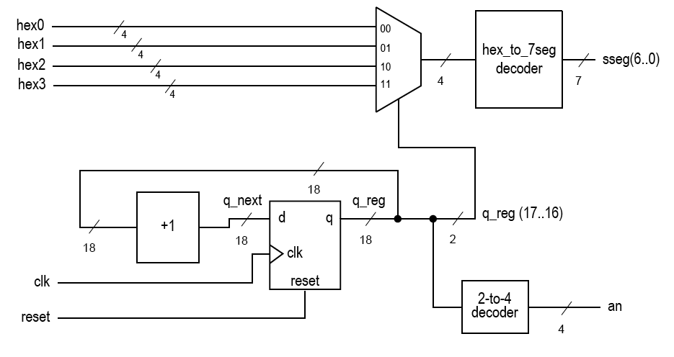
SSD_DRIVER
SEG(6..0)
Counter UP
Counter UP
q(k-1..k-2)
Counter UP
COUNTER UP
Counter UP
clk
AN
Counter UP
OC
rst
OC – One’s Complement

Slide 8
Debouncing Buttons
key bounce
t_{BOUNCE}
key bounce
t_{BOUNCE}
pulse width
Bouncing period typically smaller than 10 ms.
Pulse width typically greater than 200-500 ms.

Slide 9
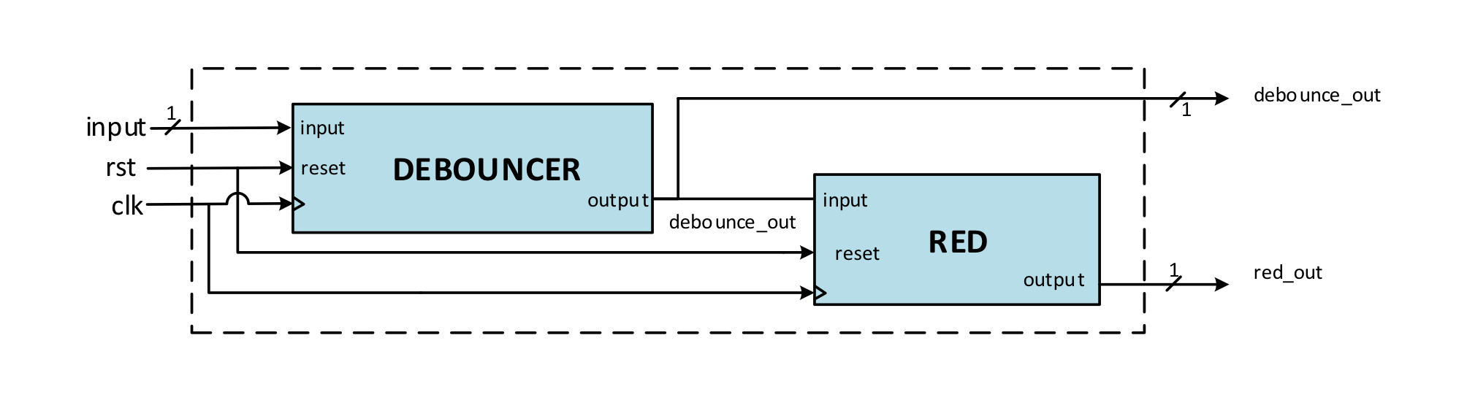
Using DEBOUNCE_RED
to Generate Short Pulses (1)
RED – Rising Edge Detector

Slide 10
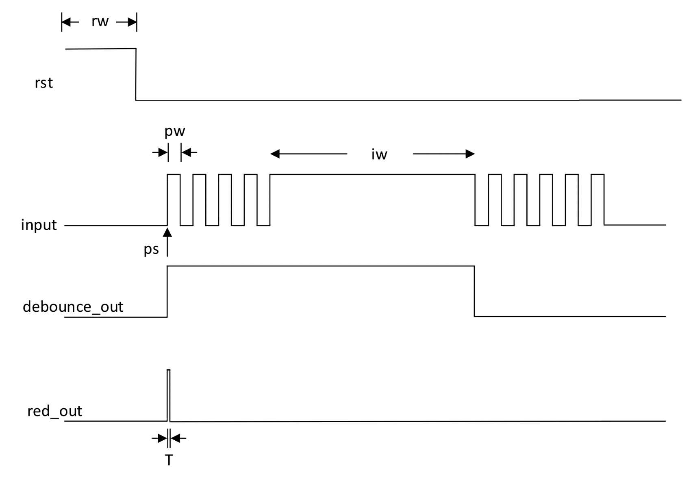
Using DEBOUNCE_RED
to Generate Short Pulses (2)

Slide 11
Debouncer
reset
Debouncer
output
input
clk

Slide 12
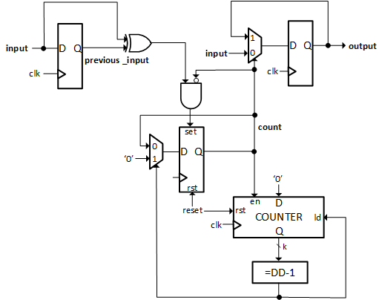
Debouncer

Slide 13
k and DD Generics
k - width of the counter used to measure the debouncing period
DD - debouncing period in clock cycles
Values of generics given on the next slide assume that the
clock frequency = 100 MHz
and thus
clock period = 10 ns.

Slide 14
k and DD Generics
Option 1 (value used for simulation only):
DD = 100
assuming bouncing period < 1 μs = 1000 ns
condition: DD*10ns = 1000 ns => DD = 100
k=7 because 2^7 > 100
Option 2 (values used for synthesis, implementation,
and experimental testing):
DD = 1000000
assuming bouncing period = 10 ms
condition: DD*10ns = 10ms => DD = 1,000,000
k=20 because 2^20 > 1,000,000

Slide 15
Rising Edge Detector - RED
Rising Edge Detector
Turn a step function into an impulse
Allows a step to run a circuit for only one clock cycle

Slide 16
Rising Edge Detector
reset
rising edge detector
input
q
output
clk
clk
input
q
output

Slide 17
Approach 1
Input & Output Interfaces
included in the Datapath

Slide 18
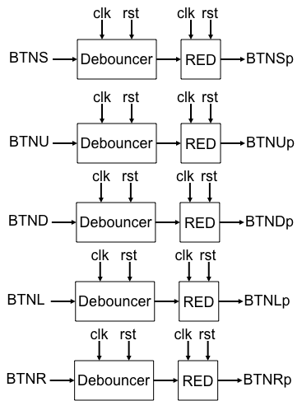
BTNC
BTNCp
rst
rst
clk
clk
4
4
4
4
0
hex3
hex2
hex1
hex0
clk
clk
D
en
enc
SSD_DRIVER
rst
rst
Q
ld
ldc
= 1s
time_out
7
4
SEG
AN

Slide 19
Structure of a Typical Digital System
Data Inputs
Control & Status Inputs
Control
Signals
Datapath
(Execution
Unit)
Controller
(Control
Unit)
Status
Signals
Data Outputs
Control & Status Outputs

Slide 20
BTNU
BTNL
BTNS
BTND
BTNR
clk
rst
BTNC
BTNCp
BTNSp
BTNUp
BTNDp
BTNLp
BTNRp
DATAPATH
time_out
CONTROLLER
subtract
en
sel
2
sel_out
enc
ldc
7
4
SEG
AN

Slide 21
ASM
Charts
ldc
enc
, enc
p
BTNCp
p
p
p
BTNCp
p
p

Slide 22
Approach 2
Separate
Input & Output Interfaces

Slide 23
BTNC
BTNCp
Block
diagram
of the INPUT_INTERFACE

Slide 24
hex_out
Block
diagram
of the OUTPUT_INTERFACE
16
4
4
4
4
hex3
hex2
hex1
hex0
clk
rst
SSD_DRIVER
7
4
SEG
AN

Slide 25
Block
diagram
of the DATAPATH
0
clk
D
en
enc
rst
Q
ld
ldc
= 1s
time_out
rst
rst
clk
clk

Slide 26
BTNU
BTNL
BTNS
BTND
BTNR
BTNC
clk
rst
INPUT_INTERFACE
BTNUp
BTNLp
BTNSp
BTNDp
time_out
BTNCp
BTNRp
subtract
en
DATAPATH
sel
2
CONTROLLER
sel_out
enc
ldc
16
hex_out
clk
rst
OUTPUT_INTERFACE
7
4
SEG
AN

Slide 27
ASM
Charts
ldc
enc
, enc
p
BTNCp
p
p
p
BTNCp
p
p

